Slide 1


E+ ADSEE
Applied Data Science Educational Ecosystem
Retail
Business Problem Decomposition

Slide 2
Business Problem Decomposition
Journey 1 Case Block
USE CASE BLOCKS
Operationalization
of results
Business
problem/task
decomposition
Sample
data set
development
Data science
Technique
selection
Model
development
Results
decomposition
Approach
analysis
Data
selection
CONTENT
1
2
3
4
5
6
7
8

Slide 3
Module Overview
Business
problem/task
decomposition
L1: Problem structuring
L2: Moving from Marketing 4.0 to Marketing 5.0
L3: Steps to acquire data
1
The meaning behind common AI terminology
What AI realistically can--and cannot--do
How to spot opportunities to apply AI to problems in your own organization
How to navigate ethical and societal discussions surrounding AI

Slide 4
We cannot solve our problems with the same level of thinking that created them.
Albert Einstein

Slide 5
Problem structuring
1
Half the battle in a successful data science driven project is expressing the problem in a way that ensures an optimal data-driven solution, with a clear set of realistic and achievable objectives.

Slide 6
Problem structuring
1
Problem structuring involves understanding four key questions:
What business problem do we want to solve (in a precise, well defined way)? The solution should be undertaken largely by financial, operational or other expert staff rather than the technology team. What exactly would be the commercial benefit of solving this problem?

Slide 7
Problem structuring
1
What data is available that might help solve this problem?
How exactly can we use point 2 to solve point 1?
How much pre-processing will be required, what techniques and technologies will be used, and what timelines, resources and budgets are required?

Slide 8
Problem structuring
1
Do these plans fit in with the rest of the business mandate and are these plans aligned with the overall strategy? If you have properly addressed the first 3 questions, this answer should be a yes, but it is always worth a final check.

Slide 9
Problem structuring
1
It is at points 3 and 4 that seemingly well-structured projects often become unstuck. A granular analysis at this stage can save much subsequent hair-tearing and disappointment.

Slide 10
Quick test
Q1
How many key questions must be understood for successful problem structuring?

Slide 11
So, let’s answer the key questions

Slide 12

Business problem
1
Our business is a worldwide leader in superior travel bags, luggage, and accessories combining notable style with the latest design technology
and the utmost attention to quality and durability.

Slide 13
Business problem
1
The business problem that we will try to solve is to create a more personalized and targeted advertising approach to connect our business to the unique needs of our customers.

Slide 14
The commercial benefit
1
The problem is a part of the company’s client-centric business strategy that is based on putting the customer first and at the core of the business in order to provide a positive experience and build long-term relationships.

Slide 15
The commercial benefit
1
The commercial benefit of solving this problem will be:
  personalising the user experience
  improving targeted marketing
  product or service personalisation
  increasing revenue by improving product recommendations

Slide 16
““Many companies have forgotten they sell to actual people. Humans care about the entire experience, not just the marketing or sales or service. To really win in the modern age, you must solve for humans.”
Dharmesh Shah, CTO & Co-Founder, HubSpot

Slide 17
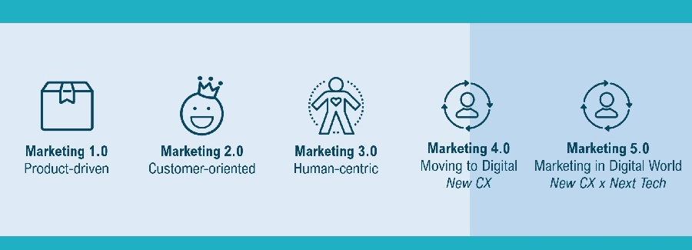
The Marketing Evolution
1
Source: Source: Philip Kotler, Hermawan Kartajaya, Iwan Setiawan, Marketing 5.0: Technology for Humanity, 2021

Slide 18
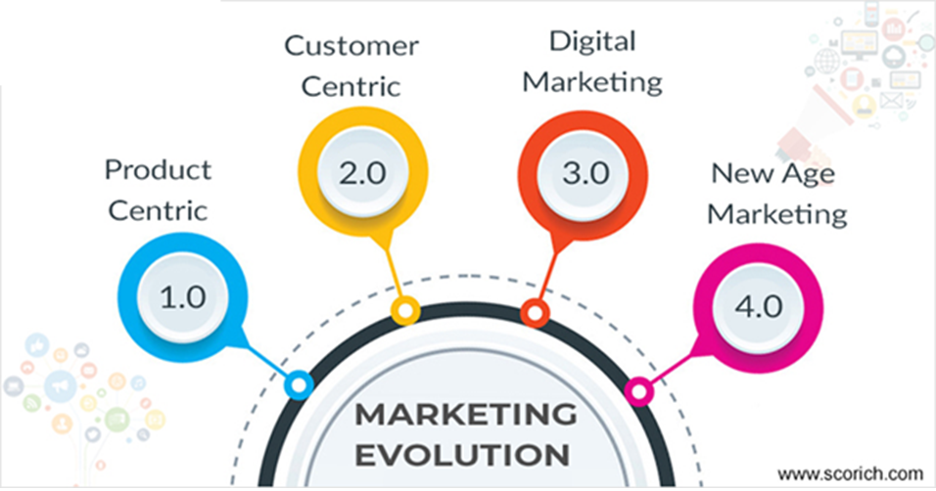
Marketing 4.0 move to Marketing 5.0
1
The ability to advertise and target products to customers in real time is a logical next step in Marketing 4.0.
Consumers want to feel seen and get exactly what they are looking
for almost instantly; this
new technology is
a strong step in that direction.

Slide 19
What is Marketing 4.0?
1
“Marketing 4.0 is a marketing approach that combines online and offline interaction between companies and customers. In the digital economy, digital interaction alone is not sufficient. In fact, in an increasingly online world, offline touch represents a strong differentiation. Marketing 4.0 also blends style with substance. While it is imperative for brands to be more flexible and adaptive due to rapid technological trends, their authentic characters are more important than ever.”
^{Philip Kotler: “Marketing 4.0“}

Slide 20
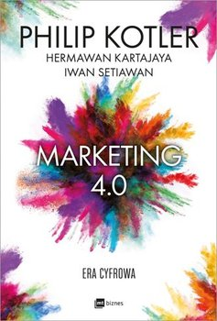
Marketing 4.0 in a nutshell
1
Marketing strategies come and go and they promise to work, or at least do until they are replaced by new ones.
From 4P’s and AIDA, we now have Kotler’s strategy, the 5A’s,
which work in line with the current online technology.
Kotlers 5A’s model does not disregard the other ones - he
recognises other paths that customers can opt to use to
purchase products.
These can be traditional, digital or a mixture of both.

Slide 21
5A’s
1
A1
A2
A3
A4
A5
AWARE
APPEAL
ASK
ACT
ADVOCATE
Customer Behaviour
Customers are passively exposed to a long list of brands from past experience, marketing communications and/or recommendations
Customers process the messages they are exposed to and become attracted to a short list of brands
Customers actively research for more information from local people, the media and directly from brands.
Based on more information, customers decide to buy and interact deeper through purchases, usage and/or service processes
Over time, customers may develop a strong sense of loyality: retention, repurchasing,and advocacy
Possible Customer Touch Points
Learn more about the brand from others
Exposure to brand advertising
Recalling past experiences
Become attracted to brands
Create a set of brands for consideration
Call on friends for advice
Conduct online research
Contact the call center
Price compare
Try the product in stores
Buy in-store or online
Use product
Complain about a problem
Obtain service
Keep using the brand
Repurchase the brand
Recommend the brand to others
Key Customer Impression
I know
I like
I’m convinced
I’m buying
I recomend

Slide 22
Quick test
Q6
Name 5A’s in Marketing 4.0

Slide 23
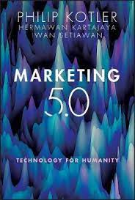
Marketing 5.0 is born
1
Inspired by the philosophy of Society 5.0 - which contains a roadmap to create a sustainable society supported by smart technologies - Marketing 5.0, by definition, is the application of human-mimicking technologies to create, communicate, deliver, and enhance value across the customer journey.

Slide 24
Marketing 5.0 in a nutshell
1
One of the critical themes in Marketing 5.0 is what we call the next tech, which is a group of technologies that aim to emulate the capabilities of human marketers.
It includes AI, NLP, sensors, robotics, augmented reality (AR), virtual reality (VR), IoT, and blockchain.
A combination of these technologies is the enabler of Marketing 5.0

Slide 25
Marketing 5.0 is born
1
Augumented marketing
Data-driven marketing
Predictive marketing
Agile marketing
Contextual marketing

Slide 26
Two critical organizational disciplines
1
The activity of collecting and analyzing big data from various internal and external sources as well as building a data ecosystem to drive and optimize marketing decisions.
This is the first discipline of Marketing 5.0: every single decision must be made with sufficient data at hand.
Data-driven marketing

Slide 27
Two critical organizational disciplines
1
The use of decentralized, cross-functional teams to conceptualize, design, develop, and validate products and marketing campaigns rapidly.
The organizational agility to deal with the ever-changing market becomes the second critical discipline companies must master.
Agile marketing

Slide 28
Three interrelated applications
1
The process of building and using predictive analytics, sometimes with machine learning, to predict the results of marketing activities before launch.
This first application allows businesses to envision how the market will respond and proactively influence it.
The use of digital technology to improve the productivity of customer-facing marketers with human-mimicking technologies such as chatbots and virtual assistants. This combines the speed and convenience of digital interface with the warmth and empathy of people-centric touchpoints.
Augumented marketing
Predictive marketing
Contextual marketing
The activity of identifying and profiling as well as providing customers with personalized interactions by utilizing sensors and digital interfaces in the physical space. – this is the backbone of one-to-one marketing in real-time, depending on the customer context.

Slide 29
““Many companies have forgotten they sell to actual people. Humans care about the entire experience, not just the marketing or sales or service. To really win in the modern age, you must solve for humans.”
Dharmesh Shah, CTO & Co-Founder, HubSpot

Slide 30
Quick test
Q7
Name two critical organizational disciplines

Slide 31
Quick test
Q8
Name three interrelated applications

Slide 32
5.0 AI Collaboration Era:
1
All this is important:
  To understand the complete process of the synergy between technology and human talent
  to determine the scope, advantages and limitations that each part has
  with the aim of finding ways to fully exploit the potential of each when working in a coordinated way

Slide 33
Simply put
1
In the past, data analysis was used to provide insight into past customer behavior
Today, data science can be used to predict future behaviors
The data exploration tool uses artificial intelligence and mathematical modeling to discover a new set of insights.

Slide 34
Quick test
Q9
What is the difference between data analysis and data science?

Slide 35
5.0 conclusion
1
Based on this data, today marketing experts can answer questions such as:
  Who are your most promising customers?
  How do people feel about your brand?
  What other products do your customers want to buy?

Slide 36

5.0 conclusion
1
By using data science, a marketing team can eliminate waste and target customers
in ways that are cost-effective
and personalized.

