Slide 1


E+ ADSEE
Applied Data Science Educational Ecosystem
Retail
Approach Analysis

Slide 2
Approach Analysis
Journey 2 Case Block
USE CASE BLOCKS
Operationalization
of results
Business
problem/task
decomposition
Sample
data set
development
Data science
Technique
selection
Model
development
Results
decomposition
Approach
analysis
Data
selection
CONTENT
1
2
3
4
5
6
7
8

Slide 3
Module overview
Approach
analysis
L4: Data and channel selection
L5: DOOH and privacy concerns
L6: Client brief
2
About this Modul
AI is everywhere! By harnessing the power of Artificial Intelligence, businesses and marketers have amazing growth potential, and the opportunities to enhance marketing with AI are always expanding. But how can businesses use AI tools to drive their success and gain sustainable competitive advantages? What are the challenges faced by businesses as they implement AI into their marketing strategies?
In this course, you will learn:
How to use data-driven AI to improve customer engagement
How to develop networked business models and leverage network effects
How to build a sustainable competitive advantage from data gathered on digital platforms
How to use algorithms, networks, and data to create AI Relationship Moments that are personalized to individual customers

Slide 4
Discussion: Take a look at the marketing’s journey the eras and skills:
D1
1.0 Analog Era: Big capital, big brands and ad budgets
2.0 Digital Era: Marketing with tracking, data-driven optimization
3.0 Network/Social/Mobile Era: User-generated content, inbound, communities, brands as publishers
4.0 Growth Era: Full lifecycle experience management, marketing stack, APIs
5.0 AI Collaboration Era: Use AI in your tech stack as a force multiplier before your competitors do
Can you imagine what Marketing 6.0 will bring?

Slide 5
Quick test
Q11
What are the steps to aquire data?

Slide 6
“Our whole role in life is to give you something you didn't know you wanted. And then once you get it, you can't imagine your life without it.”
Tim Cook CEO of Apple

Slide 7
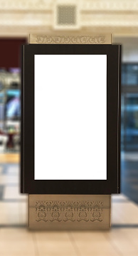
Channel selection
2
Channel we selected:
  Digital OutOfHome
Why?
  Consumers spend roughly 70%
  of time away from home

Slide 8
Channel selection
2
Advantages DOOH advertising over
other types of advertising:
      Reach large audiences
      Target with greater impact
      Measure results and refine strategies

Slide 9
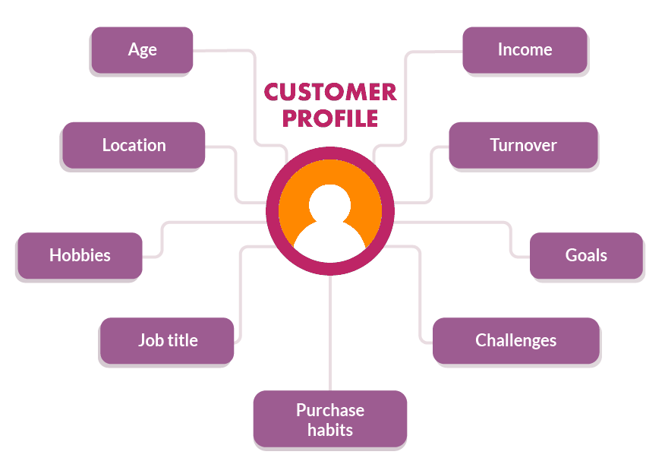
What data?
2
Based on the target groups for the advertising campaign defined by
the client following data
will be collected:
  Gender
  Age group
  Objects like bags, backpacks, bicycles

Slide 10
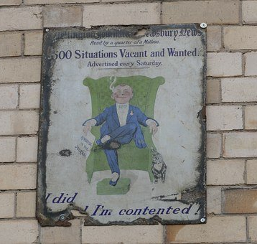
DOOH advertising
2
OOH (out-of-home advertising) was
disregarded until recently
because of its
lack of ability to provide
attribution or consumer data.

Slide 11
DOOH advertising
2
Transformation from traditional out-of-home advertising to digital out-of-home (“DOOH”) advertising or any “digital media endorsing audio and video messages related to products or services outside of the home.” illustrates how the advertising industry is leveraging new technologies to continue the pursuit of personalization and customization.

Slide 12
Benefits of DOOH Advertising
2
DOOH Advertising advantages over other types of advertising:
Reach large audiences - DOOH advertising helps capture and keep customer attention in outdoor and public spaces.

Slide 13

Benefits of DOOH Advertising
2
Target with greater impact - Because ads can be changed over the course of the day or week,
digital advertisements can do
a better job targeting
the right audiences.

Slide 14
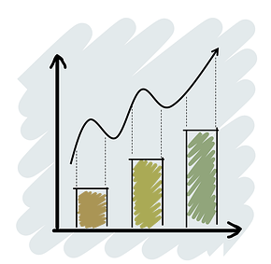
Benefits of DOOH Advertising
2
Measure results and refine strategies - When paired with analytics, digital signage offers real-time attribution data and impact, both offline-to offline, and offline-to-online. This helps media networks and their customers increase the impact of their advertising efforts.

Slide 15
Quick test
Q12
What are the benefits of DOOH Advertising?

Slide 16
“40% of Marketing and Sales teams say data science encompassing AI and machine learning is critical to their success as a department.”
Dresner Advisory Services’6th annual
2019 Data Science and Machine Learning Market Study

Slide 17
Emerging technologies
2
Mobile marketing: A rising number of DOOH units interact in various ways with portable devices, particularly mobile phones.
SMS messaging and Bluetooth are used to send rich content (like ringtones or movie trailers)
Or consumers can download a coupon, play games, or enter contests through their mobile phones.

Slide 18
Emerging technologies
2
Social networking: Some DOOH units provide access to social networks like FB, Twitter, TikTok through the Web or apps on consumersʼ mobile devices.
In some applications, consumers can send user-generated messages, photos and other content to specific DOOH screen locations in real time.

Slide 19
Emerging technologies
2
Radio Frequency Identification (RFID): The most common use of RFID in DOOH features RFID-enabled shelves that prompt nearby digital signage units to display advertisements related to the products on the shelves. Other DOOH systems air ads triggered by shopper loyalty cards equipped with RFID.6

Slide 20
Emerging technologies
2
Facial recognition: Increasingly, DOOH units use facial measurement technology to discern certain characteristics about a person looking at the display.
Some systems can calculate a passerbyʼs age, gender, and race, and determine how long an individual watches the display.

Slide 21
Emerging technologies
2
DOOH uses other technologies, such as GPS (to a lesser extent), which have more potential to combine with DOOH to create interactive experiences for consumers.
Clearly DOOH can integrate many technologies to collect a broad range of consumer data in various contexts.

Slide 22
Quick test
Q13
Name at least two emerging technologies?

Slide 23
Leveraging new technologies
2
We will focus on use of biometrics and artificial intelligence in aiding increased personalization, precision, and attribution in the digital out-of-home (“DOOH”) advertising sector.

Slide 24
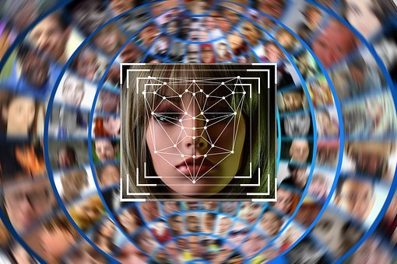
Biometrics
2
Biometrics are body measurements and calculations related to human characteristics.
It can be used as a form of
identification, access control
and the identify individuals
in groups.

Slide 25

Artificial intelligence (AI)
2
Artificial Intelligence is defined as a “that seeks to remedy this situation by creating software and hardware that possesses
some of the behavioral flexibility
shown by natural intelligences,
both human and animal.”

Slide 26
Quick test
Q14
What is Biometrics?

Slide 27
DOOH drivers of innovation
2
Biometrics and artificial intelligence are just two of the many technologies currently transforming the advertising industry but are significant drivers of innovation in the DOOH advertising sector due to their unparalleled ability to create personalization and targeted advertising.

Slide 28
Discussion:
D2
As AI further develops and merges with technology like digital signage, the level of personalization will grow to a great extent.
The question is only how far?

Slide 29
““All human beings have three lives: public, private, and secret.”
Gabriel García Márquez

Slide 30

Privacy concerns
2
Using identification and interactivity technologies, the DOOH and mobile industries
are taking the Internet
experience into the physical world.

Slide 31
Privacy concerns
2
As with many other new technologies, so with facial recognition technology, a large number of consumers might be concerned about their own privacy and the protection of personal data.

Slide 32
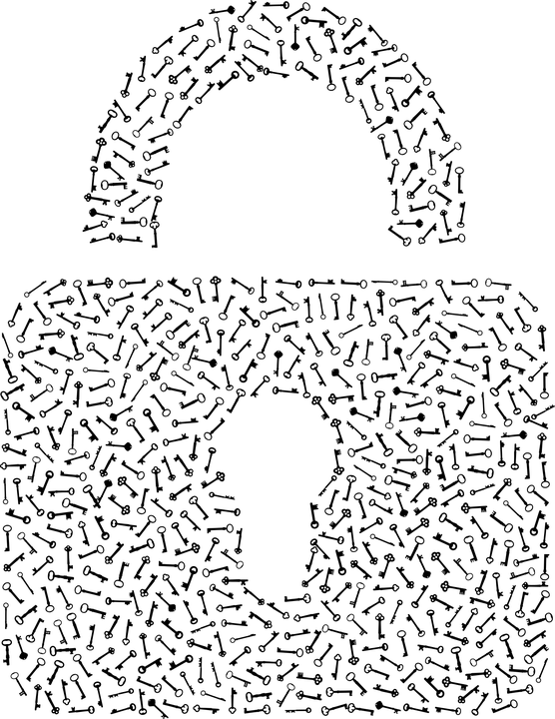
Privacy concerns
2
Unlike traditional digital advertising, fortunately, tracking DOOH audience data is
different from what is done online,
which means that many of these
problems are greatly reduced,
if not eliminated.

Slide 33
Privacy concerns
2
DOOH audience data is collected and stored in a state of semi-anonymity.
This means that while audience data is tracked, no individual’s personal information is ever stored.

Slide 34
Semi-anonymity sample
2
A person goes to the mall, sees a digital sign, and pauses in front of it
He or she watches an ad for a new phone and leaves when an ad for a luxury vacation package plays

Slide 35
Semi-anonymity sample (cont.)
2
Throughout this process, it is likely that some data about that person have been collected.
Firstly, the mall owner has likely counted that person and all foot traffic with simple IR sensors placed near the entrances.

Slide 36
Semi-anonymity sample (cont.)
2
Over time, this helps the mall owner build a very good picture of the traffic patterns at certain times and days of the year.
In transit, equivalent data is collected by turnstiles.
In Cinema, it’s ticket sales

Slide 37
Quick test
Q15
Provide one semi-anonymity sample

Slide 38
The bottom line
2
While DOOH audience data is collected, it is much less specific than online data, and does not result in specific campaigns being targeted to specific people.
Rather, the data is collected to illuminate patterns in audience activity and preference that can be used to better target campaigns to appropriate audiences – not specific individuals.

Slide 39
The GDPR directive and DOOH
2
There is no impact of the GDPR directive on DOOH at all. Or at least not directly.
The anonymized nature of DOOH audience data shows that they are outside the scope of the GDPR.

Slide 40
The GDPR directive and DOOH
2
When data are collected from other channels, such as mobile devices or locations, appropriate permissions should be provided for access to these data sources.

Slide 41
The GDPR directive and DOOH
2
Overall, the fact that the GDPR touches the DOOH space so lightly means that the DOOH is increasingly seen as a good replacement for those network channels that are now more strictly regulated.

