Slide 1


E+ ADSEE
Applied Data Science Educational Ecosystem
Retail
Sample Data Set Development

Slide 2
Sample Data Set Development Journey 6 Case Block
USE CASE BLOCKS
Operationalization
of results
Business
problem/task
decomposition
Sample
data set
development
Data science
Technique
selection
Model
development
Results
decomposition
Approach
analysis
Data
selection
CONTENT
1
2
3
4
5
6
7
8

Slide 3
Module Overview
Sample Data Set Development
L1: Problem structuring
L2: Moving from Marketing 4.0 to Marketing 5.0
L3: Steps to acquire data
6
The meaning behind common AI terminology
What AI realistically can--and cannot--do
How to spot opportunities to apply AI to problems in your own organization
How to navigate ethical and societal discussions surrounding AI

Slide 4

Client brief
6
Samsonite is the worldwide leader in superior travel bags, luggage, and accessories
combining notable style with
the latest design technology
and the utmost attention
to quality and durability.

Slide 5
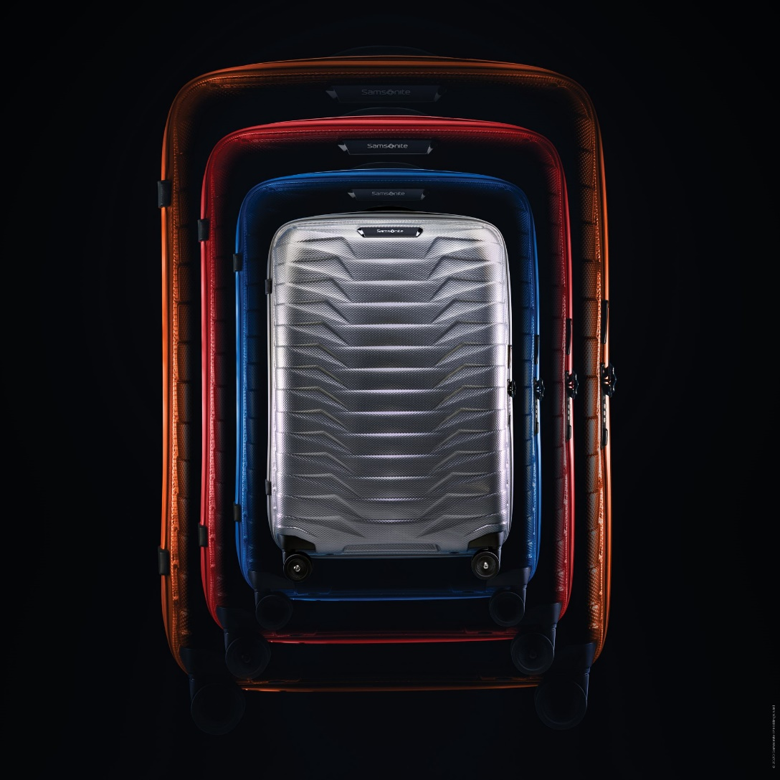
Client brief
6
For more than 100 years,
Samsonite has leveraged its
rich design heritage to create
unparalleled products that fulfill
the on-the-go lifestyle needs of
the business professional.

Slide 6
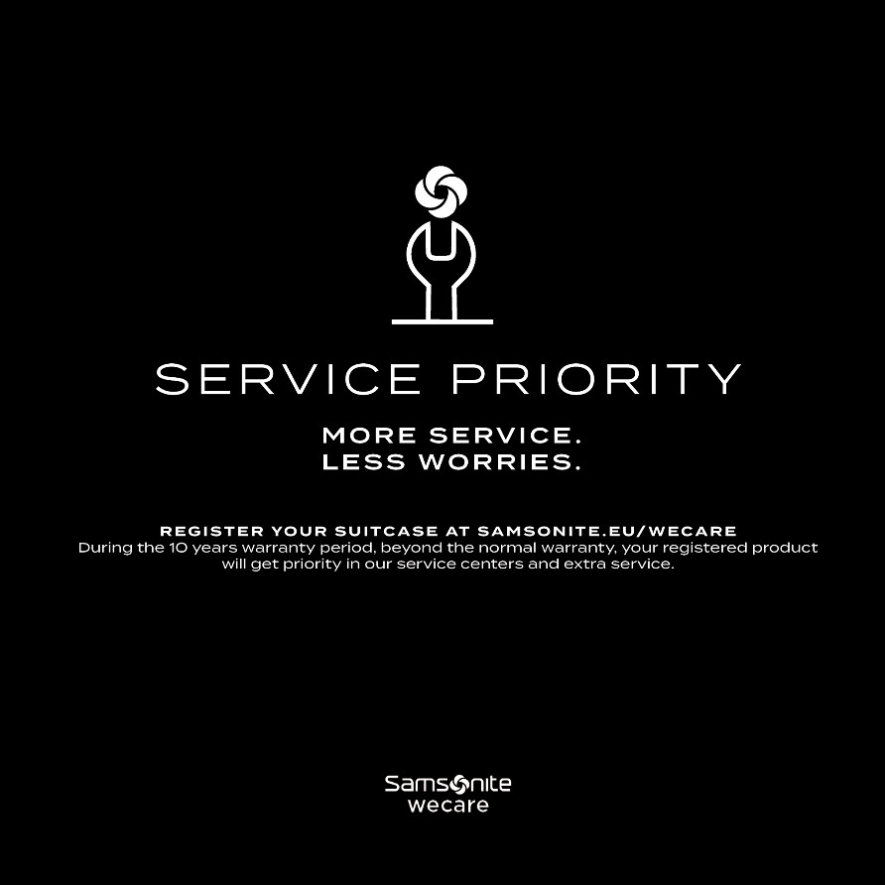
Client brief
6
Samsonite history is rooted in innovation from inventing the first truly durable tapered vulcanized fiber suitcase to developing technologies that make the bags more comfortable, lightweight and worry free.

Slide 7
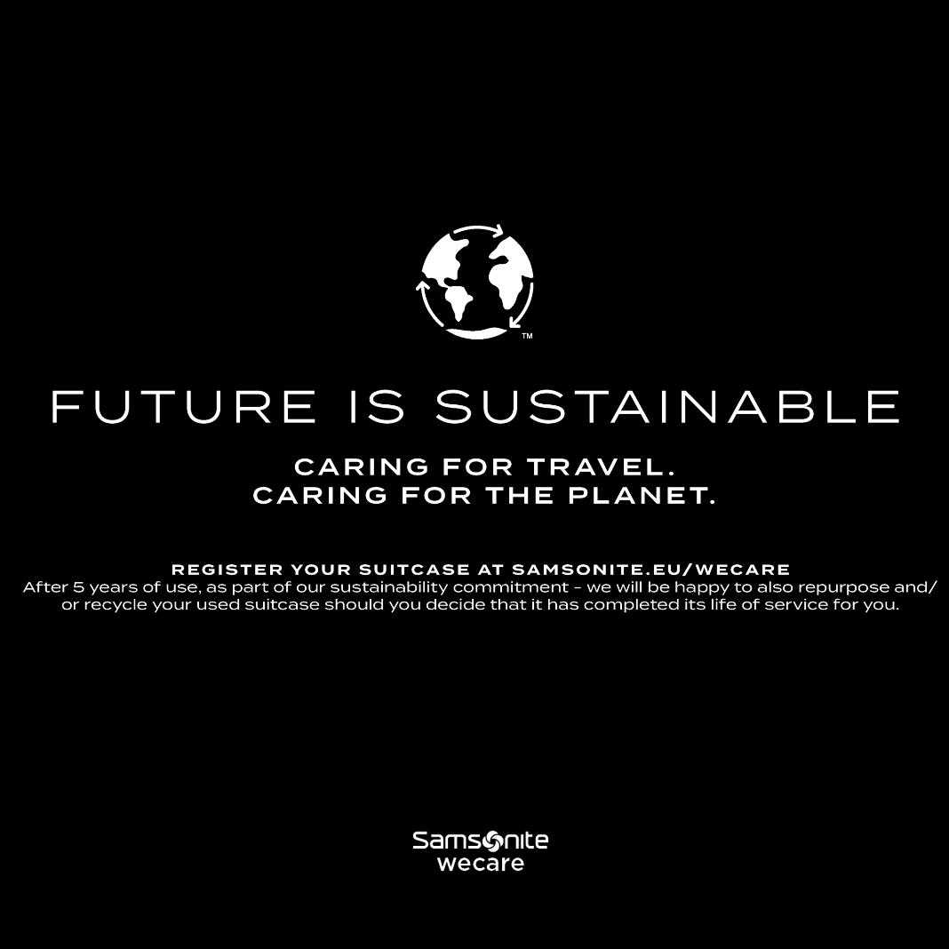
Client brief
6
The brand strives to constantly
evolve Samsonite world renowned
comfort, bringing customers the
most advanced technologies
available today in luggage,
bags and backpacks.

Slide 8

Client brief
6
Samsonite created a new campaign with the objective to increase brand awareness and 20% demand of the Samsonite backpacks.

Slide 9

Client brief
6
The campaign consists of three videos intended for the male and female population between 20 and 40 years of age and those who already own a backpack.

Slide 10
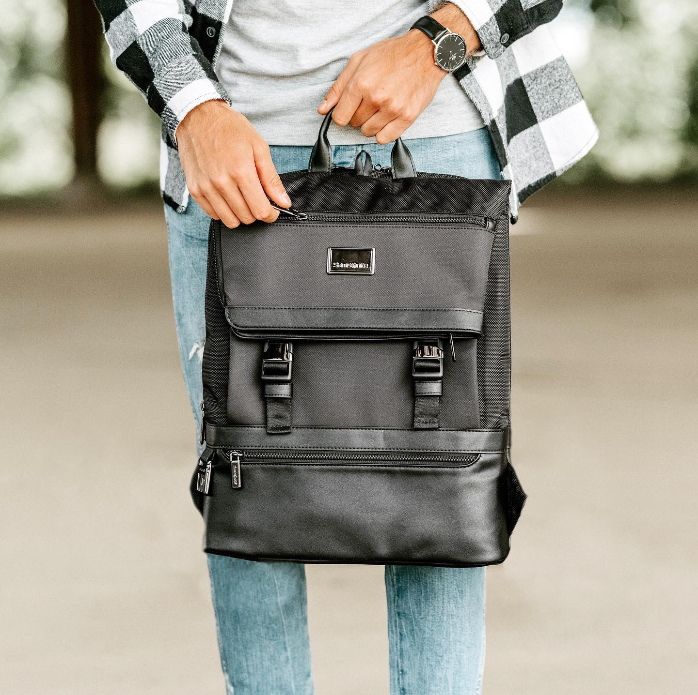
Client brief
6
The target audience should belong to ClassA, ClassB and a portion of ClassC with a lifestyle that expects the following: comfort, functionality and style.

Slide 11

Client brief
6
People wearing these backpacks
should want to feel natural, relaxed, authentic, and with a young, free, simple and healthy spirit.

Slide 12
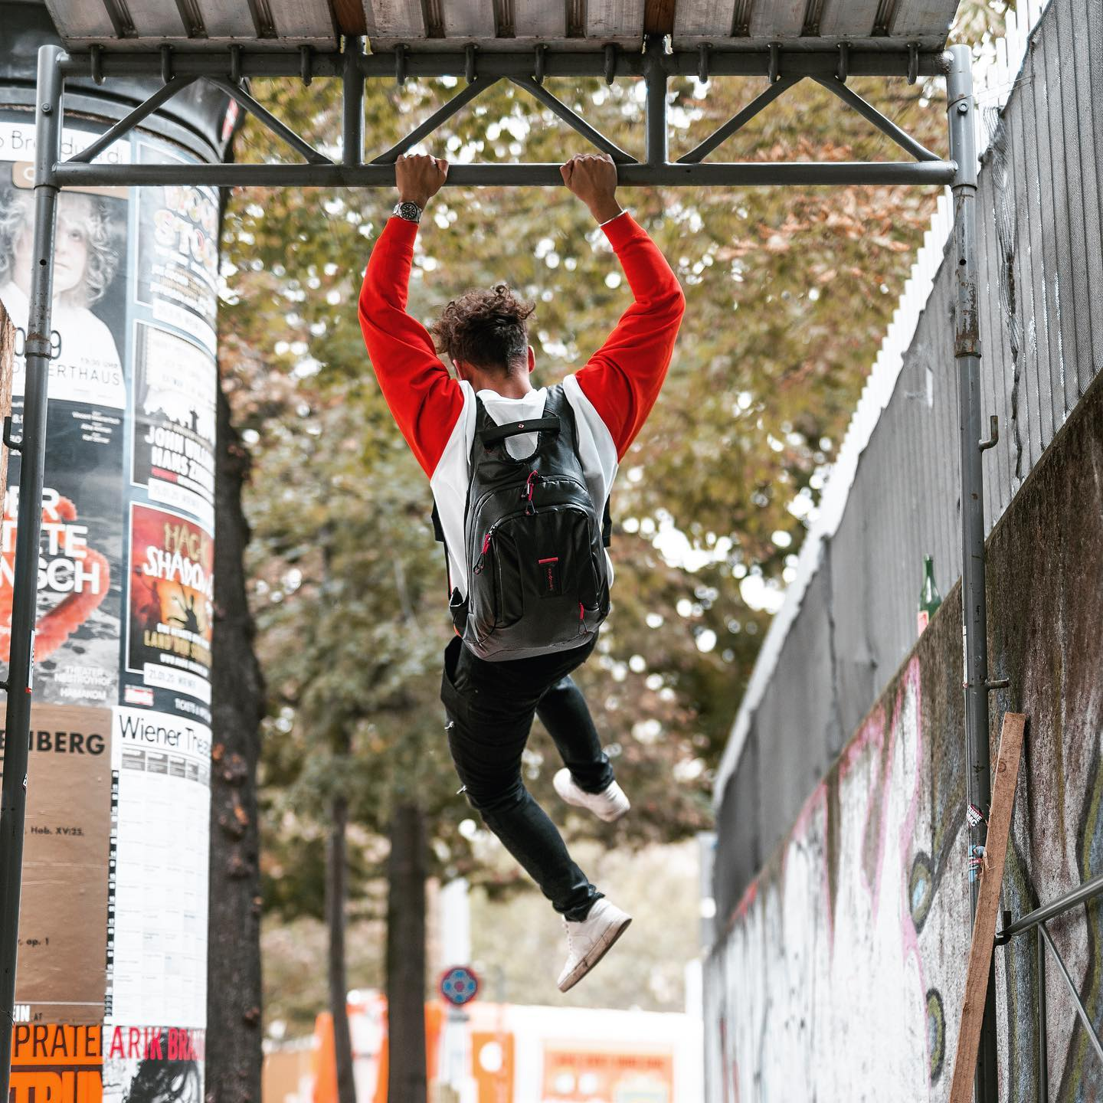
Client brief
6
The main consumer message is “Backpacks for wherever the day takes you”.

Slide 13
“Those who flow as life flows know they need no other force.”
Lao Tzu

Slide 14
Flow of the system
6
Upon receiving the client's brief, GigBig divided the flow of the system into four phases: video/image collection, (multiple) object detection from video media, identification of target groups and targeted advertising.

Slide 15
Flow of the system
6
In the initial stage, images are captured by a video camera and serve as input for the system.
These images are processed in the system and passed to algorithms.

Slide 16
Flow of the system
6
In the second phase, the detection of (multiple) objects is implemented to detect different types of objects in a single image or frame. The algorithm then recognizes the discovered faces by gender and age group. An analysis is made to determine the majority group at that point, and the results go into the algorithm for selecting ads.

Slide 17
Flow of the system
6
In the next phase, data is entered into the ad database where the content is selected, marked by desired targets which are recognized by input results. The content is then transferred to the digital billboard to be displayed.

Slide 18
Flow of the system
6
The selection of advertising video is based on the maximum number of recognized object categories.
As the gender and age recognition and multiple object recognition are implemented with models, the recognition results are retrieved separately.

Slide 19
Quick test
Q17
How many phases does our flow system consist of?

Slide 20
Flow of the system
6
For instance, if most adult women are recognized at a certain point in time, advertisements relevant to this group will be displayed on the billboard.
On the other hand, if the number of recognized objects is greater than the number of recognized persons, the object category with the greatest number will be referred to select an advertisement related to it.

Slide 21
Flow of the system
6
The final phase is the display of the advertisement relevant to the real-time demographic.
The process reiterates when the profile of detected crowd changes.

Slide 22
Discussion:
D4
The technology is improving — but the bigger issue is how it’s used.
Just because a technological capacity exists, does that mean it should be pursued?
What factors should companies take into account when determining whether or not to launch an AI-based advertising campaign?

