Slide 1


E+ ADSEE
Applied Data Science Educational Ecosystem
Retail
Result Decomposition

Slide 2
Result Decomposition
Journey 7 Case Block
USE CASE BLOCKS
Operationalization
of results
Business
problem/task
decomposition
Sample
data set
development
Data science
Technique
selection
Model
development
Results
decomposition
Approach
analysis
Data
selection
CONTENT
1
2
3
4
5
6
7
8

Slide 3
Module overview
Result
decomposition
L29: Intelligent targeted advertising system
L30: Face recognition
7

Slide 4
Intelligent targeted ad system
7
Intelligent targeted advertising system presented to advertisers is aimed at providing a better experience of advertising to both advertisers and audiences.
An intelligent targeted advertising system consists of several integrated functionalities, including gender and age recognition, the identification of different facilities and the detection of several objects.

Slide 5
Intelligent targeted ad system
7
The technology of the multiple detection of objects enables detection of different types of objects in one picture, and enables the detection and recognition of human faces and different types of objects.
Facial recognition is carried out in order to recognize gender and age on the basis of characteristics.

Slide 6
Quick test
Q20
What intelligent targeted advertising system is being targeted?

Slide 7
Intelligent targeted ad system
7
Our data selection process is driven with goals set by the client’s brief
Based on our goal, we should select data that shows what some billboard “sees” in some prime location in some city

Slide 8
Intelligent targeted ad system
7
For that purpose, a YouTube video was used that shows people passing by in a main walking street named La Rambla in Barcelona
Although the video is slowly “walking” through La Rambla, we can assume that the same population would be encountered if we just attached a camera to some billboard on La Rambla to see who is passing by.

Slide 9
Intelligent targeted ad system
7
With a deep video analysis based on modern data science techniques, the following information is gained:
  The frequency of people passing by (by hour, minute, time of the day, weekday, weekend days)
  Statistical information about objects detected in video/images (persons, bicycles, bags, mobiles phones etc.)
  The age and gender of people passing by

Slide 10
Quick test
Q21
What information are we acquiring?

Slide 11
Intelligent targeted ad system
7
The system flow outline is:
  Step 1. – getting a video from YouTube and storing it locally on our server. Total size of 11 min high resolution video was around 500 MB.
  Step 2. - extracting images every 5th second of video.
Result: A video which is 11 min long and gives us a total of 133 images

Slide 12

Intelligent targeted ad system
7
System flow is:
  Step 1. – getting a video from YouTube and storing it locally on our server. The total size of the video is 11 min long, high resolution 500 MB video.
  Step 2. - extracting an image every 5th sec
Result: a video which is 11 min long and gives us a video total of 133 images

Slide 13
Intelligent targeted ad system
7
The system uses a computer vision technique to identify objects.
Computer vision is a field of artificial intelligence that trains computers to interpret and understand the visual world, or the world as we, humans, see it.
By using digital images from cameras and computers, we can accurately identify and classify various objects — and then react to what they “see.

Slide 14
Intelligent targeted ad system
7
The system uses computer vision technique to identify objects.
Computer vision is a field of artificial intelligence that trains computers to interpret and understand the visual world, or the world as we, humans, see it.
Using digital images from cameras and computers, we can accurately identify and classify various objects — and then react to what they “see.

Slide 15
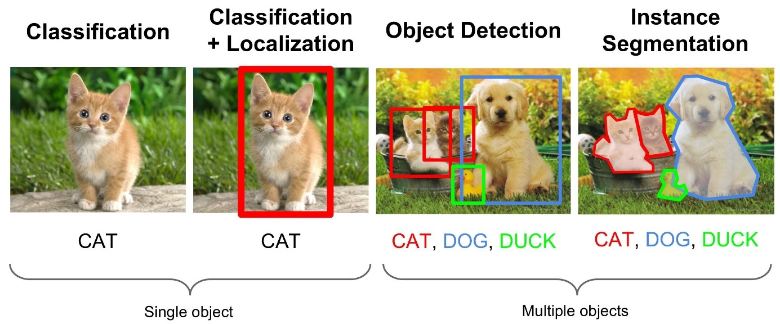
Intelligent targeted ad system
7
The identification of different object types in images and in video: people, animals, cars, bicycles, bags…
We can create an algorithm
that will be trained to
recognize specific types
of objects like men or
women belonging to a
specific age group

Slide 16
Intelligent targeted ad system
7
How can this technology help us in marketing?
Modern marketing likes to deliver “targeted” ads - If you don’t know who is watching, then you can show just about any ad and hope that the person who is watching will be interested.
But if I show you that the person is male in the 28-35 year old age group, then you will know that you will not show an ad about a pension plan to that type of audience.

Slide 17
Discussion:
D5
Do you recognize the practical usages of this technology?
Is it applicable in real life situations?

Slide 18
““The face is a picture of the mind with the eyes as its interpreter.”
Marcus Tullius Cicero

Slide 19
Face recognition Training
7
How does this training work?
  You can use https://teachablemachine.withgoogle.com/ to create your AI model in a few minutes without prior knowledge of anything related to AI.
  It’s a fun way to learn how computer algorithms learn to recognize reality which is the foundation of AI

Slide 20
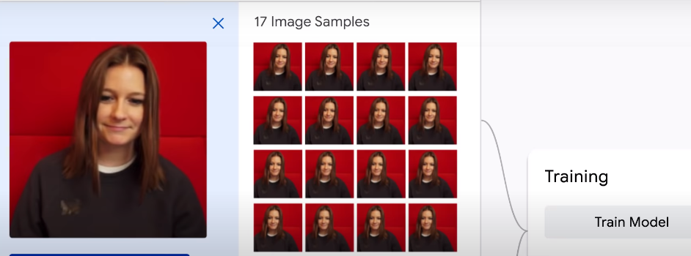
Face recognition Training
7
Let’s say that you want to build a model which will recognize only you or your dog in images.
1. take a tone of images of yourself

Slide 21
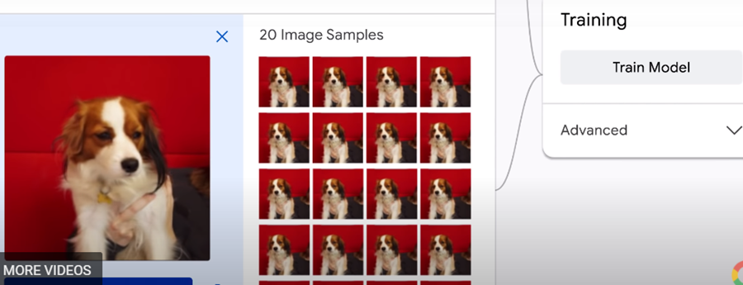
Face recognition Training
7
2. take a tone of images of your dog

Slide 22

Face recognition Training
7
3. train the model

Slide 23
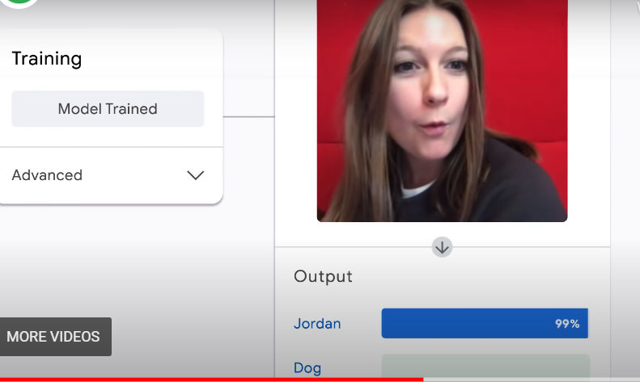
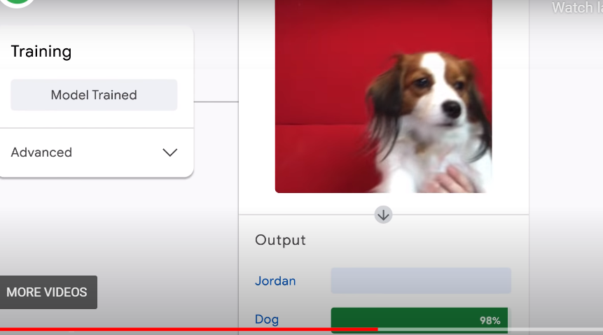
Face recognition Training
7
Step 4. use your model

Slide 24
Face recognition Training
7
What’s everything you have to do in order to detect faces?
  The same mechanism is applied – we give an algorithm to a tone of faces, train it and then it should be able to successfully recognize faces in images.

Slide 25
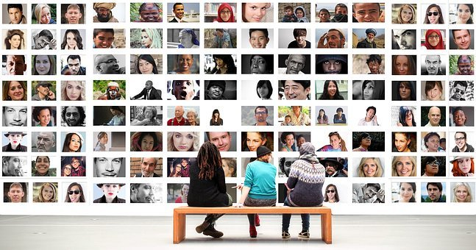
Face recognition Training
7
In the same way that we trained an algorithm to detect faces, we can train it to detect
gender groups as well
You just need a large
number of photos of male and female

Slide 26
Quick test
Q22
What’s all this have to do with detecting faces?

Slide 27
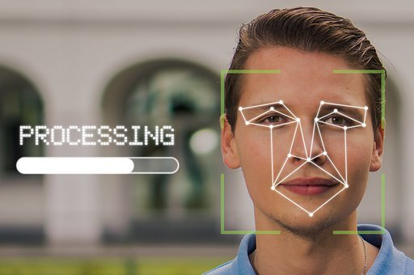
Face recognition
7
Because faces are so complicated, there isn’t one simple test that will tell you if it has found a face or not.
For something like a face,
you might have 6,000 or more
classifiers, all of which must
match for a face to be
detected.

Slide 28
Face recognition
7
The algorithm may have 30 to 50 of these stages or cascades, and it will only detect a face if all stages pass.
The advantage is that the majority of the picture will return to a negative during the first few stages.
That means that the algorithm won’t waste time testing all 6,000 features on it.

Slide 29

Face recognition
7
Instead of taking hours, face detection can now be done in real time.

Slide 30
Quick test
Q23
How many classifiers can be used to recognize a face?

Slide 31

Face recognition
7
We used a Deepface program that helped us
to detect age, gender, ethnicity and
emotions from faces on our images.
Deepface is a face recognition and
facial attribute analysis (age, gender,
emotion and race) framework.

Slide 32
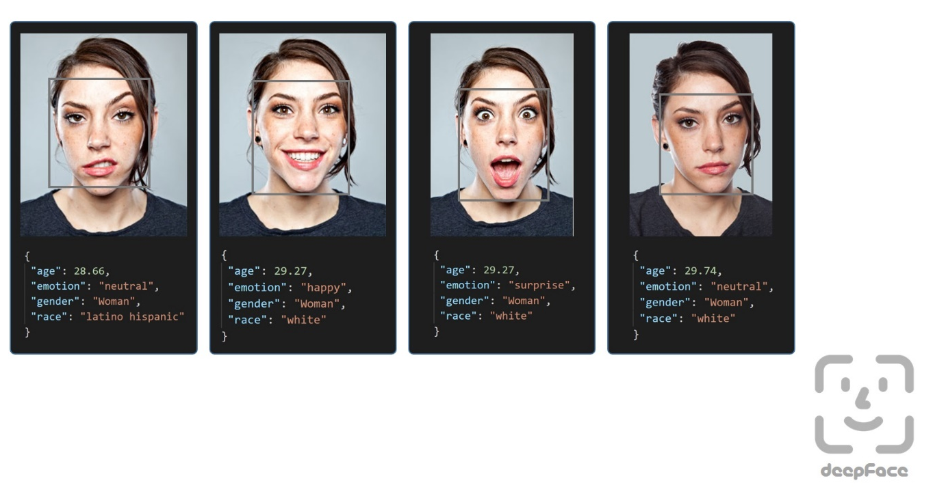
Face recognition
7
We used a Deepface program that helped us to detect age, gender, ethnicity and emotions from faces on our images.
Deepface is a face recognition
and facial attribute analysis
(age, gender, emotion and
race) framework.

Slide 33
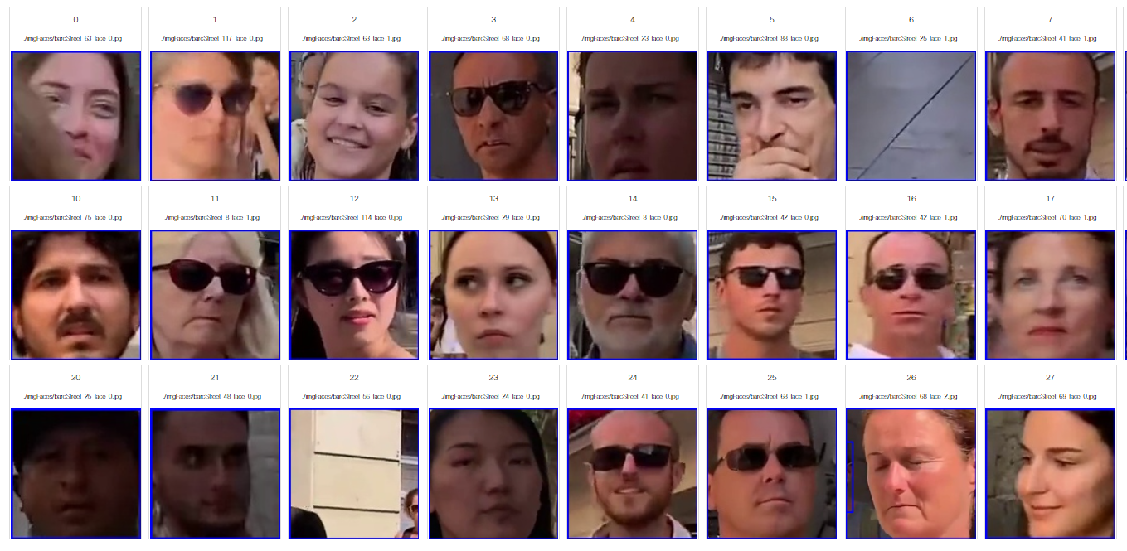
Face recognition
7
So, the algorithm that we used performs pretty well on people in the age range between 20 - 40, especially women
It correctly identified
the differences between
woman aged 24 and
woman aged 31

Slide 34
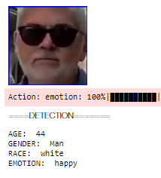
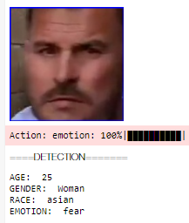
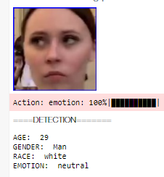
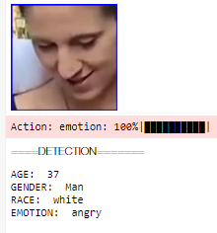
Face recognition
7
But, men who were identified as 44 years old
were definitely at least 20 years older
It also failed to correctly identify
age and even gender
for people below 20 years of age.

Slide 35
Face recognition
7
Conclusion:
  It is quite normal for the algorithm to have such weaknesses.
  One way to amend this would be to increase number of images that are incorrectly classified during training.
  For example - if elderly people are frequently misclassified, then we can train our algorithm to be better with more pictures of elderly people.

Slide 36
Quick test
Q24
How can an algorithm be trained to better identify specific objects?

Slide 37
Discussion:
D6
Is the future of targeted advertising positive or negative? Are you concerned for your own privacy and you think such activities would limit your life in some way?

