Slide 1


E+ ADSEE
Job Market Signalling
Result Decomposition
Interranker Reliability

Slide 2
Overview
In this notebook we measure reliability.
This is useful for the creation of custom dictionaries and is aimed at improving the quality of selection of the tokens measured by checking that the domain experts agree.
This can also be used if you want to label text.
Labelled text is useful for supervised learning tasks, to train Machine Learning Models.
You will Learn how to:
1. Generate synthetic (fake) data via the `sample` function
2. Visually check your data through the `plot` and `table` functions
3. Perform inter rater reliability statistics through the `kappa2`and `kappam.fleiss`commands
4. Explain the meaning of the p value within the context of randomness
5. Report the statistics consistently.

Slide 3
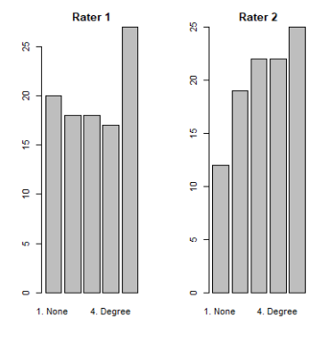
By looking at a randomly generated sample based on qualification level, and walking through the process of estimating reliability

Slide 4
Packages used in the Interanker notebook
Base R
Sample: For almost random sampling of your data set
Plot: Base R plotting
kappa2and kappam.fleiss commands to calculate reliability between 2 Rankers and pair wise comparision between > 2 experts

Slide 5
Agreement
Poor agreement = Less than 0.20
Fair agreement = 0.20 to 0.40
Moderate agreement = 0.40 to 0.60
Good agreement = 0.60 to 0.80
Very good agreement = 0.80 to 1.00

Slide 6
Resources
Examples:
http://www.cookbook-r.com/Statistical_analysis/Inter-rater_reliability/
https://support.minitab.com/en-us/minitab/18/help-and-how-to/quality-and-process-improvement/measurement-system-analysis/how-to/attribute-agreement-analysis/attribute-agreement-analysis/interpret-the-results/all-statistics-and-graphs/kappa-statistics/
Han, Cunxin. 2019. “Statistics in Corpus Linguistics: A Practical Guide.” Journal of Quantitative Linguistics 27 (4): 379–83. https://doi.org/10.1080/09296174.2019.1646069.
Larsson, Tove, Magali Paquot, and Luke Plonsky. 2020. “Inter-Rater Reliability in Learner Corpus Research.” International Journal of Learner Corpus Research 6 (2): 237–51. https://doi.org/10.1075/ijlcr.20001.lar.

Slide 7
Overview
Here we describe one workflow for creating data pipelines
Explain how to check the reliability and internal consistency of our dictionaries
Install an open source application that can help us measure the internal consistency of our dictionaries
Review text mining R packages
Look at the code and thus prepare for the final module by looking at more advanced visualizations

Slide 8
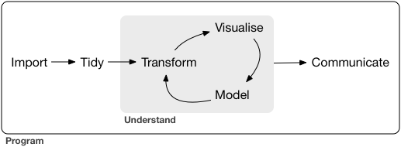
R for Data Science
ggplot2
ggthemes
ggwordcloud
DataExplorer
ggplot2
quantmod
rvest
tidycensus
tidyR
dplyr
tidytext
ggplot2
ggthemes
ggwordcloud
quanteda
tidytext
https://r4ds.had.co.nz/introduction.html

Slide 9
Why these methods?
Exploratory Data Analysis
Key Words In Context
Data Pipelines
Quick Visualizations
Sentiment, custom dictionaries, topic analysis
Data Enrichment
Expert Reliability
RMarkdown Reporting
Because we want to:
Measure the degree of agreement between experts so that we know if our constructs are valid. Later (in a more advanced course), we can use the statistical measurements to compare the experts agreement to the performance of ML algorithms.

Slide 10
Reliability, Validity, Accuracy, Precision
Content Analysis Cookbook
Reliability: Are the results the same if we repeat the trial or resample data?
Validity: Are our constructs measuring what we think they should?
Accuracy: Is there any bias (none white noise error) in our data.
Precision: How well can we distinguish between groups
Note, that the terms are also used when looking at the performance of Machine Learning Algorithms, so it is important to differentiate/

Slide 11
The role of the expert
The domain expert has the central role:
  Understanding the context
  Asking the right questions
  Choosing the right corpus
  Selecting the techniques
  Naming the themes of the topics
  Defining code books on how to label content
  Tweaking (not the dance) the results. For example, you might perform a cluster analysis to choose words for your dictionaries and there may be words that are at the edge of clusters. The expert might place discard the word.
  Labelling content ready for supervised Learning (spam, not spam, etc)
  To be compared against the performance of ML models

Slide 12
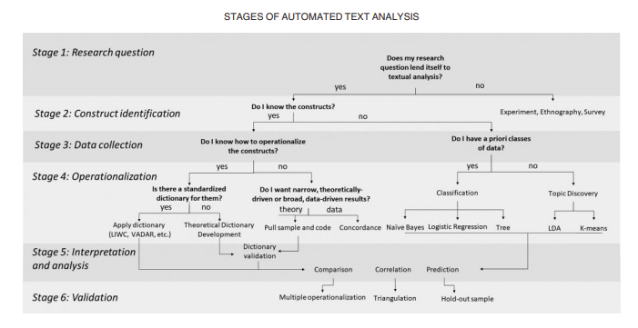
Workflows
https://www.researchgate.net/publication/324495873_Automated_Text_Analysis_for_Consumer_Research

Slide 13
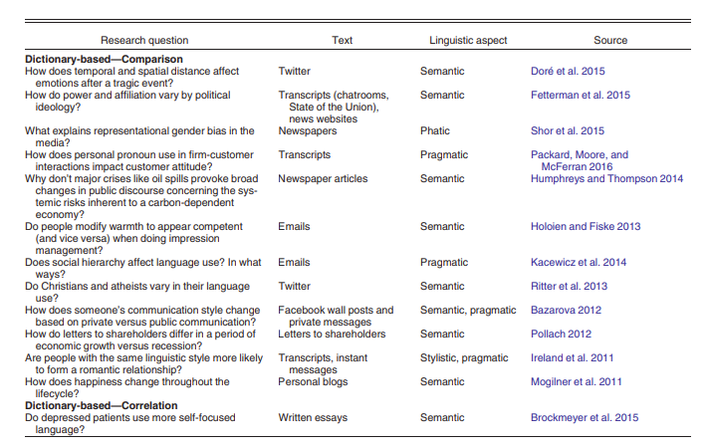
Example Research questions
Phatic
relating to, or being speech used for social or emotive purposes rather than for communicating information

Slide 14
Theory and Rational
Conceptualizations
Operationalizations
Computer Coding
Sampling
Coding
Tabulation, visualization, Reporting
Based on Page 50
The Content Analysis Guidebook

Slide 15
Theory and Rational
Conceptualizations
Operationalizations
Computer Coding
Sampling
Coding
Tabulation, visualization, Reporting
Literature Review
Content Selection

Slide 16
Theory and Rational
Conceptualizations
Operationalizations
Computer Coding
Sampling
Coding
Tabulation, visualization, Reporting
Literature Review
Content Selection
Variable selection

Slide 17
Theory and Rational
Conceptualizations
Operationalizations
Computer Coding
Sampling
Coding
Tabulation, visualization, Reporting
Literature Review
Content Selection
Variable selection
EDA.
Motivation: The early you find an issue the cheaper it is to repair. Visualize, visualize, visualize
Choose Tokens
EDA
Review themes

Slide 18
Run the code and sanity check
Theory and Rational
Conceptualizations
Operationalizations
Computer Coding
Sampling
Coding
Tabulation, visualization, Reporting
Literature Review
Content Selection
Variable selection
Do we use the whole of the data set possible or a subset.
Choose Tokens
EDA
Review themes
Look at word frequencies, topics, etc and create dictionaries. Check that the experts agree based on a coding book

Slide 19
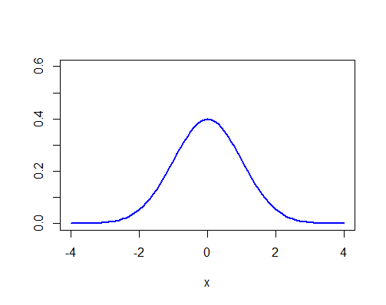
Hint for statisticians: Normal plays a role
Parametric, non parametric statistics.
Log transform of frequencies if we wish to use parametric techniques
For low frequency counts either:
  Remove from dictionary
  Log+1 transform

Slide 20
Experts need to agree
A common source of errors stems from manual coding and annotation of linguistic features. To estimate the amount of error present in a coded data set, coefficients of inter-rater reliability are used.
Also used when manual labelling categories as input to supervised Machine Learning Methods

Slide 21
Agreement
We let the computer do the hard work of Calculating Cohen’s Kappa and weighted Kappa as an index of interrater agreement between 2 raters on categorical (or ordinal) data.
A p value of > 0.05 means that we can’t be certain that the results are not random. The Z score is used to calculate the p value.
The kapper value is between the values -1 to 1 and depending which literature you have read the meaning of the kapper value are:
Poor agreement = Less than 0.20
Fair agreement = 0.20 to 0.40
Moderate agreement = 0.40 to 0.60
Good agreement = 0.60 to 0.80
Very good agreement = 0.80 to 1.00

Slide 22
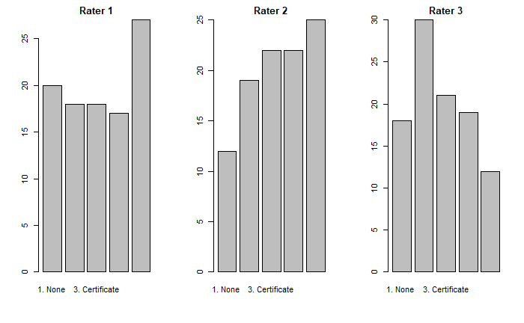
Simulation

Slide 23

Exercise
Write down at least 5 reasons why you think experts might not agree.
If in a classroom, discuss

Slide 24
Exercise
Helper tools
Make sure you have butter installed (if possible).
Consider installing Notepad++ (https://notepad-plus-plus.org/downloads/v7.9.5/)
What is the moral foundations dictionary: https://moralfoundations.org/
Review the moral foundations dictionary: https://moralfoundations.org/wp-content/uploads/files/downloads/moral%20foundations%20dictionary.dic
Describe the 11 themes

Slide 25
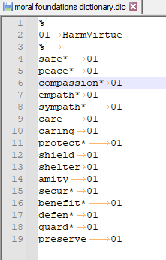
LIWC dictionaries
LIWC structure is tab sensitive

Slide 26
LIWC
The psychometric validation of LIWC categories is significant because it allows LIWC users to draw justified inferences from word frequencies to psychological states of the authors. For this reason the potential for LIWC’s use in the context of the humanities, religion in particular, is largely untapped.
https://hecc.ubc.ca/quantitative-textual-analysis/qta-practice/linguistic-inquiry-and-word-count/

Slide 27
Exercise
LWIC
Visit the LIWC website.
Look for research papers
Read the abstracts of the research papers.
Note the following:
  What were the research questions
  Which statistical methods were used
  Which dictionaries were used

Slide 28
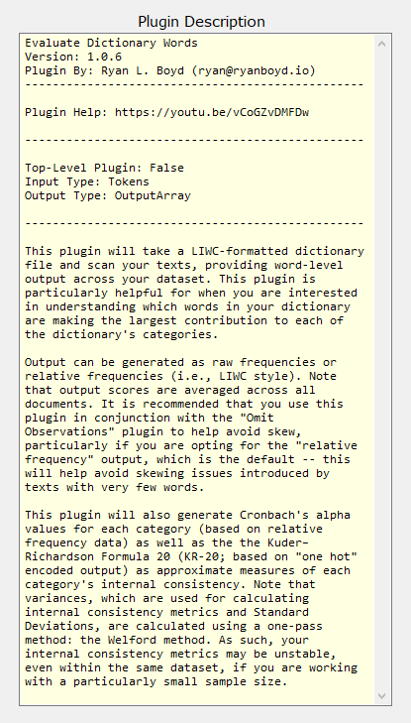
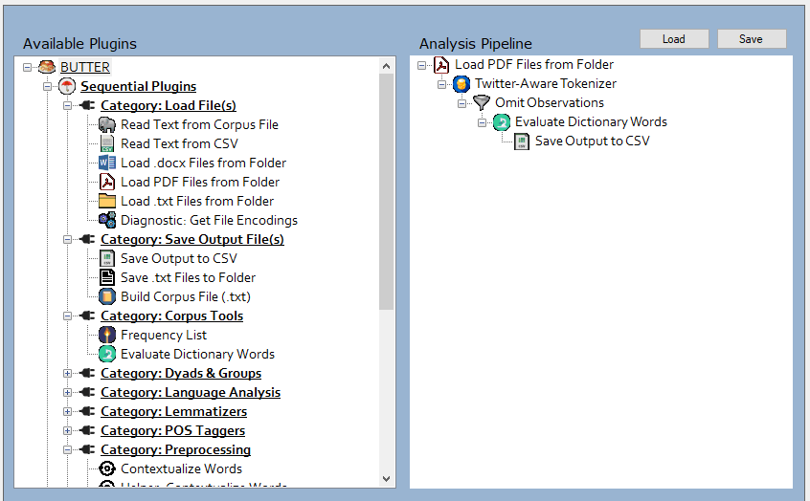

Slide 29
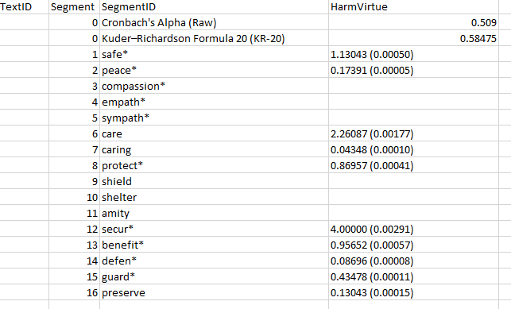
Cronbach Alpha for internal validity

Slide 30
Word, Document Embeddings
Word embeddings are an improvement on the use of td-idf in many situations
Unlike Bag of Words the weightings take into account the context of the words as well.
The process involves Shallow Neural Networks which is outside the scope of the course
Next we will show you an example use of word embeddings where we look at how the description of R packages are related to the TidyText and Quanteda packages
Motivation: At the time of writing there are about 17000 R packages. It is therefore difficult to keep track.

Slide 31
Word, Document Embeddings
Next we will show you an example use of word embeddings where we look at how the description of R packages are related to the TidyText and Quanteda packages
Motivation (1): VOLUME: At the time of writing there are about 17000 R packages.
Motivation (2): VELOCITY: There is active community creating many specialised packages
Motivation (3): FOCUS: The graphs help a developer keep up with which interesting new packages are relevant.

Slide 32
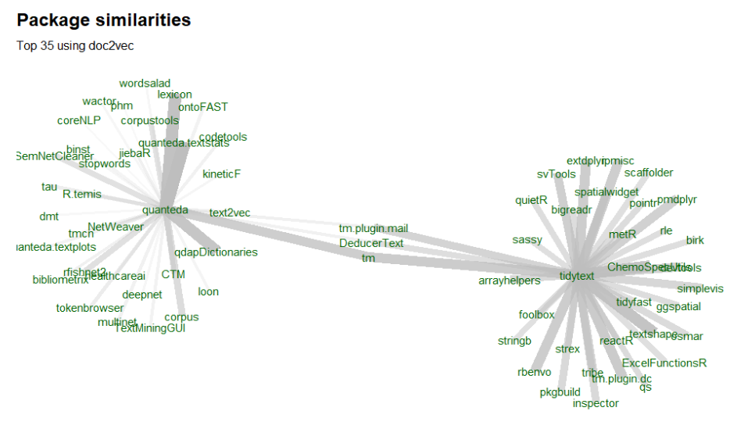
https://www.bnosac.be/index.php/blog/103-doc2vec-in-R

Slide 33
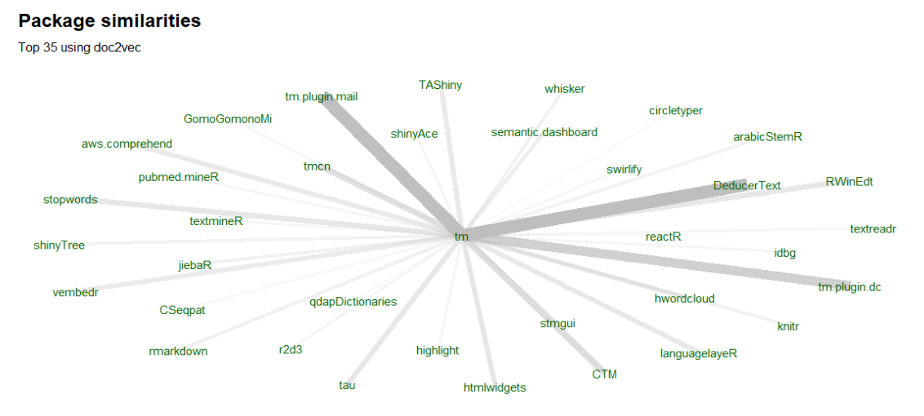

Slide 34
Exercise
For the package names associated with tidytext, quanteda and TM:
  Read the descriptions of the packages
  Note if the package is relevant
  If the package is relevant see if you can find a recipe
Which dictionaries exist and available for use? Hint, start with the stopwords and qdapdictionaries packages
Optional: Can you find and run the code mentioned in the link in the slides and see if there are any new packages associated with tidytext

Slide 35
There are other R packages that are useful
The TM package has a large ecosphere.
There are functions that help convert data types so that the main packages can work well together.
It is a little bit of a puzzle sometimes to orchestrate the packages.

Slide 36
TM and Functions
cleanCorpus <- function(corpus) {
corpus.temp <- tm_map(corpus, removePunctuation)
corpus.temp <- tm_map(corpus.temp, stripWhitespace)
corpus.temp <- tm_map(corpus.temp, tolower)
corpus.temp <- tm_map(corpus.temp, removeWords, stopwords("english"))
return(corpus.temp)
}

Slide 37
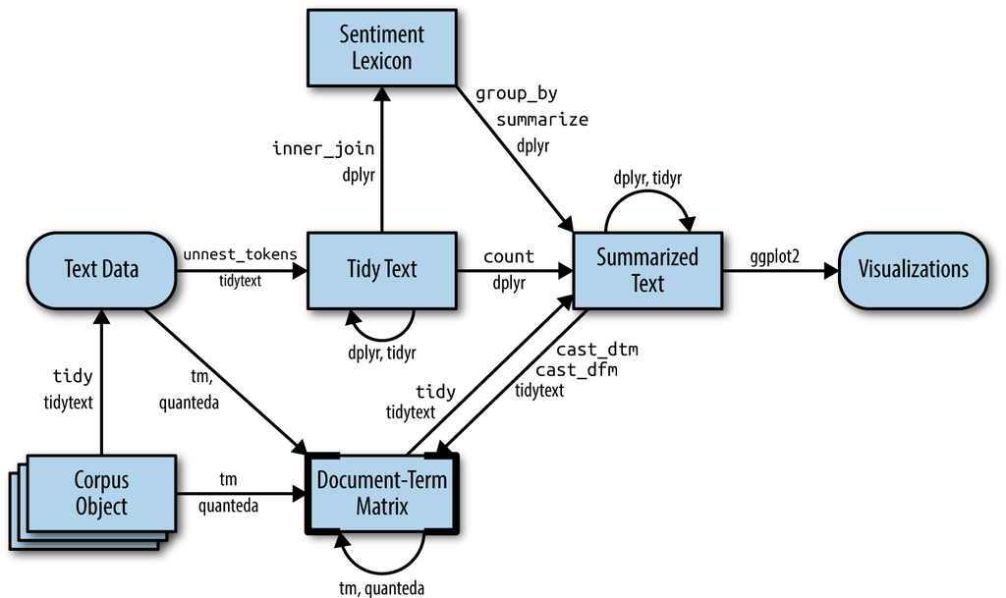
Working with other packages
https://www.tidytextmining.com/dtm.html

Slide 38

Reading List
The links in the Gender section usefulness varies.
This is typical of a search through the Internet.
Briefly review the links in the gender section:
Are there any actionable coding recipes
What are the data sources
Do any of the references mention theory
What is missing?

Slide 39
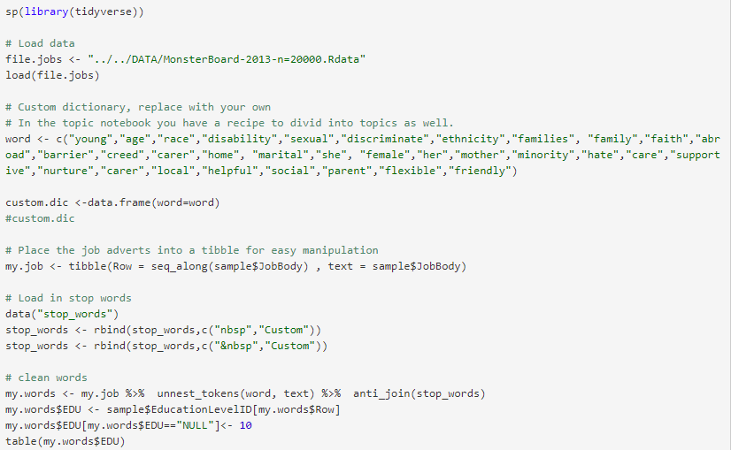
Review Code Book

Slide 40

Mentality
Be kind to yourself. You do not need to understand every detail.
Be patient.
Learning does cost energy
Read small chunks of code at a time
Keep practicing reading code. Make notes on each function
Small recipes can do a lot, so try and find those recipes
The internet is your friend
If you want to learn R for the first time then try the following:
  https://rafalab.github.io/dsbook/r-basics.html
  https://bookdown.org/dli/rguide/

Slide 41
Two code books
Inter Ranker Reliability
Finish off the coding and visualization conversation via the last coding book

Slide 42
Exercise
Review the output from the notebook .nb.html file and write in your notes the following.
List the packages used and describe their purpose
List the new functions used and what they do
Describe any short recipes in your own words
Search the internet for at least two links for similar examples

Slide 43
Exercise
Visit Google Scholar and search using a filter for papers since 2020 that are related to text mining &:
  Burning Glass
  Gender barrier (or the theme that you are interested)
Read the 5 most interesting abstracts.

Slide 44
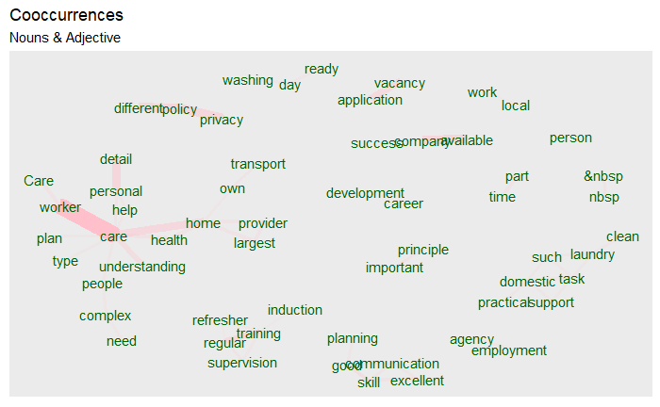
Exercise
Review the words.
Which themes are actionable?
Which words are stop_words
In the corpus using the code books and the tools, especially KWIC create dictionaries for words associated with the themes you have found or are interested.

Slide 45
Exercise
file.jobs <- "../../DATA/MonsterBoard-2013-n=20000.Rdata"
load(file.jobs)
word <- c("young","age","race","disability","sexual","discriminate","ethnicity","families", "family","faith","abroad","barrier","creed","carer","home", "marital","she", "female","her","mother","minority","hate","care","supportive","nurture","carer","local","helpful","social","parent","flexible","friendly")
custom.dic <-data.frame(word=word)
my.job <- tibble(Row = seq_along(sample$JobBody) , text = sample$JobBody)
data("stop_words")
stop_words <- rbind(stop_words,c("nbsp","Custom"))
stop_words <- rbind(stop_words,c("&nbsp","Custom"))
my.words <- my.job %>% unnest_tokens(word, text) %>% anti_join(stop_words)
my.words$EDU <- sample$EducationLevelID[my.words$Row]
my.words$EDU[my.words$EDU=="NULL"]<- 10
test <- my.words %>%
group_by(EDU) %>% count(EDU)
test2 <- my.words %>% inner_join(custom.dic) %>% group_by(EDU) %>% count(EDU)
gender.raw <- merge(test,test2, by="EDU")
gender.EDU <- data.frame(EDU=gender.raw$EDU,
TOTAL=gender.raw$n.x,
PERCENTAGE=round((gender.raw$n.y/gender.raw$n.x)*100,digits=2) )
Replace the word list with each of your dictionaries and run the code in the .RMD notebook
Review the final results in gender.EDU.
Note what you find interesting

Slide 46
Reading List
Review the links in the reading list for this module.
Write brief notes, answering the questions:
  Do the links still work
  Which links are relevant for you
  Which links are not relevant for you
  What further information would you have wished

